Slide 1


Building Microservices with Spring Boot
Workshop #1
December 2018
Itzik Shachar

Slide 2
What is Spring Boot?
It is not a framework
It’s a convention-over-configuration solution for creating stand-alone, production-grade Spring-based applications
Built on top of the Spring framework
Makes it easy to create applications that you can “just run“
Takes an opinionated view of the Spring platform and third-party libraries so you can get started with minimum fuss
Most Spring Boot applications need very little Spring configuration

Slide 3
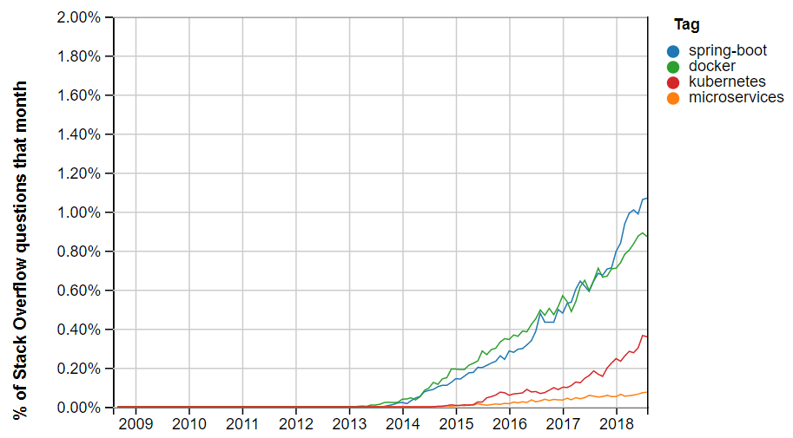

Some Statistics
Stack Overflow Trends

Slide 4
Why Spring Boot?
Getting Started
Convention over Configuration
Dependency Management
Auto Configuration
Starter Dependencies
Production Ready
Run Anywhere

Slide 5
Spring Boot Configuration

Slide 6
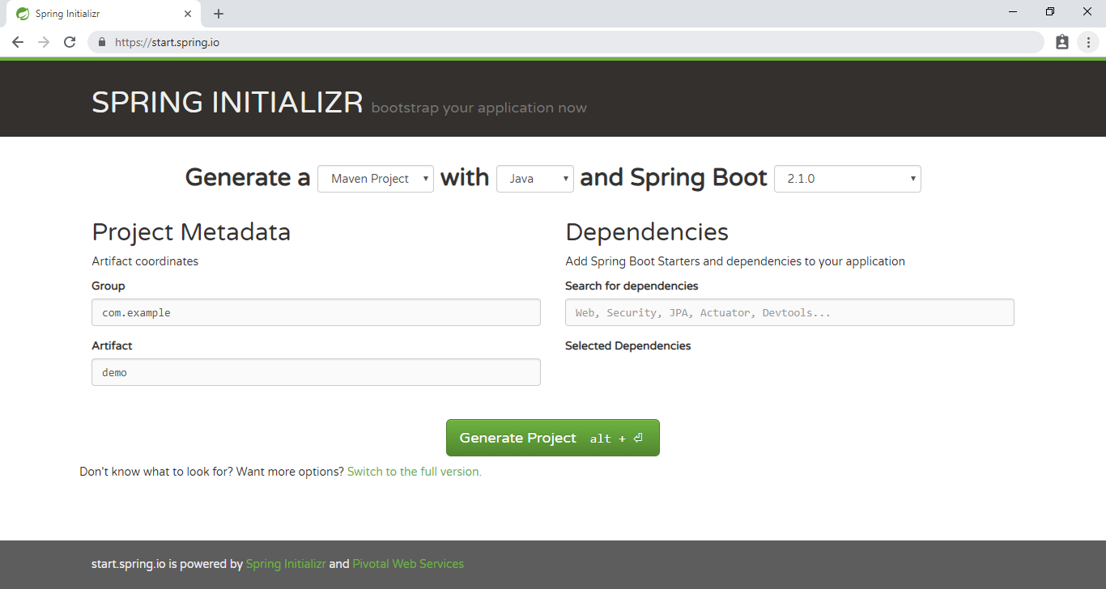
Getting Started

Slide 7
Dependency Management
“ Each release of Spring Boot provides a selected list of dependencies that it supports.
In practice, you do not need to provide a version for any of these dependencies in your build configuration, as Spring Boot manages that for you.
When you upgrade Spring Boot itself, these dependencies are upgraded as well in a consistent way. ”

Slide 8
Dependency Management Advantages
No dependencies maintenance
No conflicts between dependencies
Dependencies are verified by Spring
Improved Stability!

Slide 9
Without Dependency Management
<dependency>
<groupId>org.hibernate</groupId>
<artifactId>hibernate-entitymanager</artifactId>
<version>3.3.2.GA</version>
</dependency>
<dependency>
<groupId>javax.sql</groupId>
<artifactId>jdbc-stdext</artifactId>
<version>2.0</version>
</dependency>
<dependency>
<groupId>mysql</groupId>
<artifactId>mysql-connector-java</artifactId>
<version>5.1.14</version>
</dependency>

Slide 10
With Dependency Management
<dependency>
<groupId>org.hibernate</groupId>
<artifactId>hibernate-entitymanager</artifactId>
</dependency>
<dependency>
<groupId>javax.sql</groupId>
<artifactId>jdbc-stdext</artifactId>
</dependency>
<dependency>
<groupId>mysql</groupId>
<artifactId>mysql-connector-java</artifactId>
</dependency>

Slide 11
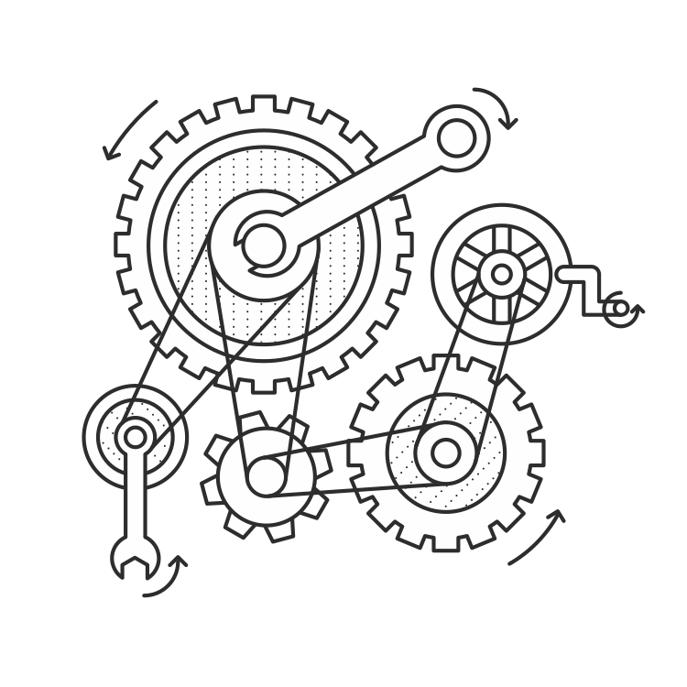
Auto Configuration
“ Spring Boot auto-configuration attempts to automatically configure your Spring application based on the jar dependencies that you have added. “

Slide 12
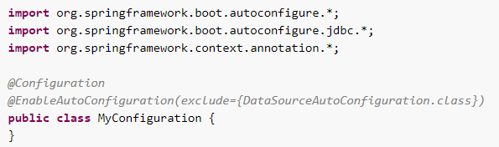
Auto Configuration
Provides default setup based on the jars in the classpath along with options to override it based on our requirements
Minimizes the number of decisions a programmer has to make when using the framework
Activated by adding @EnableAutoConfiguration or @SpringBootApplication annotations to Spring Configuration Class

Slide 13
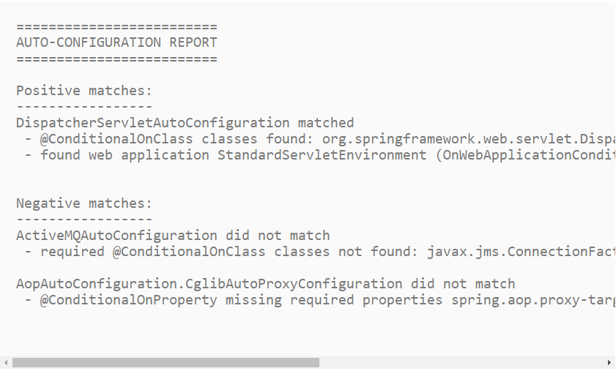
Auto Configuration
In action…

Slide 14

Starter Dependencies
Starters are a set of convenient dependency descriptors that you can include in your application
The starters contain a lot of the dependencies (Jars) that you need to get a project up and running quickly
For example, if you want to get started using Spring and JPA for database access, include the spring-boot-starter-data-jpa dependency in your project
Spring Boot Starters

Slide 15
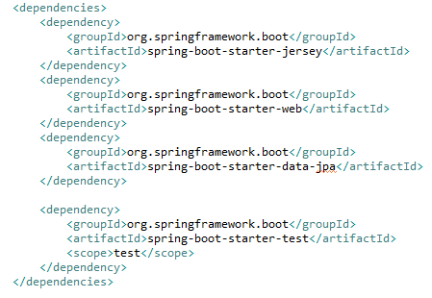
Starter Dependencies

Slide 16

Spring Boot Disadvantages
Hides the configuration from you (things work by a ‘magic’)
May potentially increase the overall service memory by adding many unnecessary jars
Saves the need to write boiler-plate code which helps the developer to get to know Spring framework
Not for control freaks

Slide 17



